Slide 1
Machine Learning
Predicting Insurance Premium for a selected dataset

Slide 2
Problem Statement
The purposes of this exercise to investigate different features to observe their relationship, and plot a multiple linear regression based on several features of individual such as age, physical/family condition and location against their existing medical expense to be used for predicting future medical expenses of individuals that help medical insurance to make decision on charging the premium.

Slide 3
The Dataset
The insurance.csv dataset contains 1338 observations (rows) and 7 features (columns). The dataset contains 4 numerical features (age, bmi, children and expenses) and 3 nominal features (sex, smoker and region) that were converted into factors with numerical value designated for each level.

Slide 4
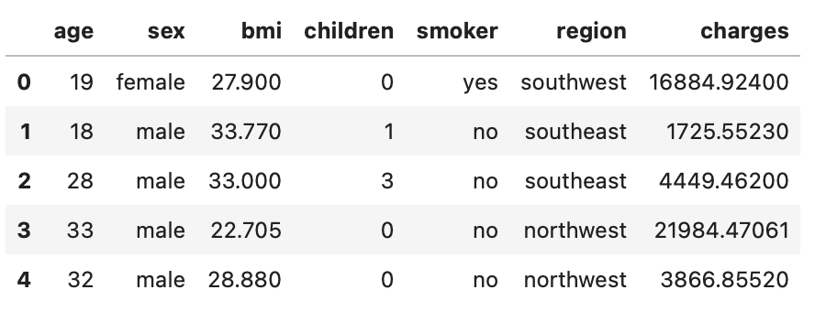
Preview of the dataset used:

Slide 5
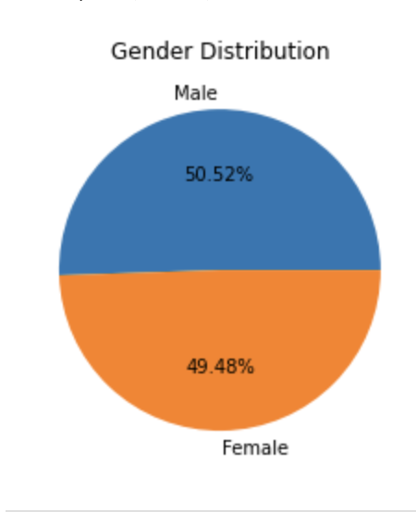
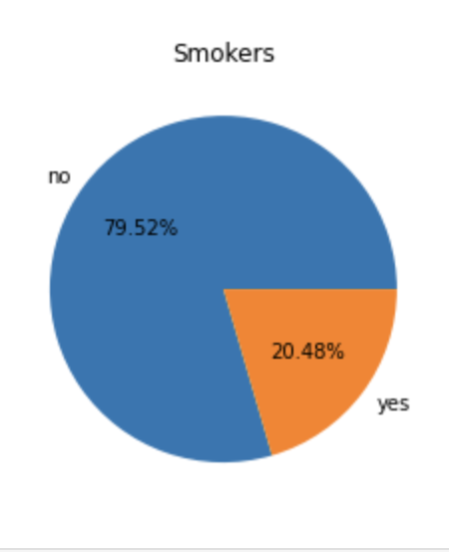
Distribution of the dataset

Slide 6
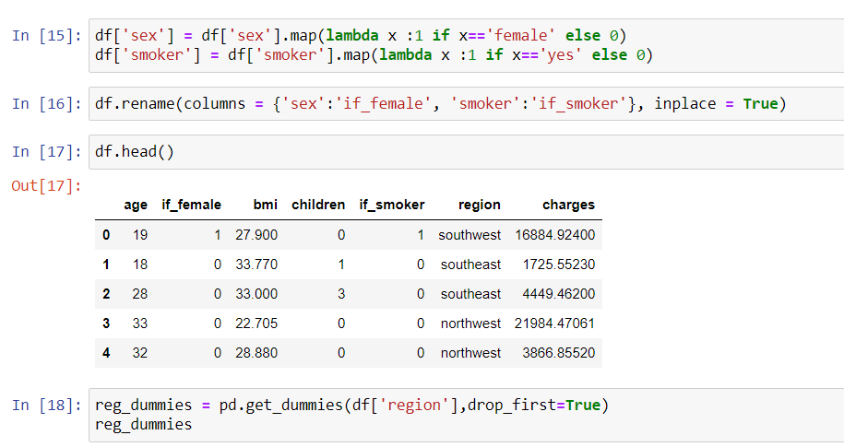
Data Preprocessing
Transposed the region columns
Converting columns such as “Sex”, “Smoker” into binary values ->
“if-female”
“if_smoker”

Slide 7
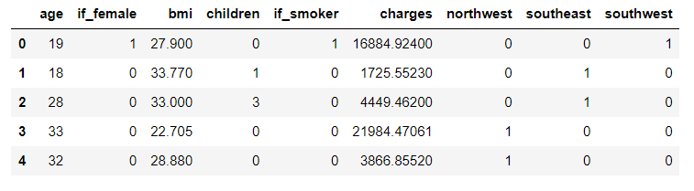
Dataset attained after Pre-Processing

Slide 8
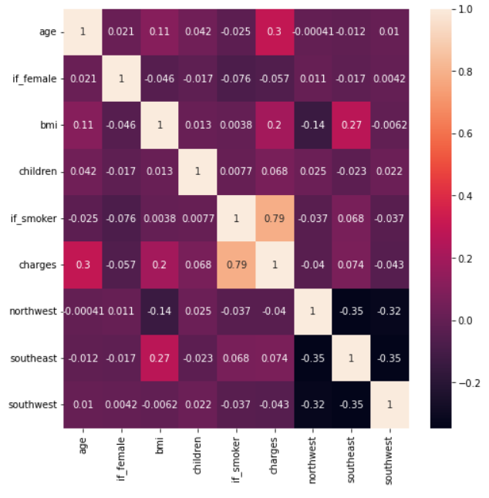
Correlation between different features

Slide 9
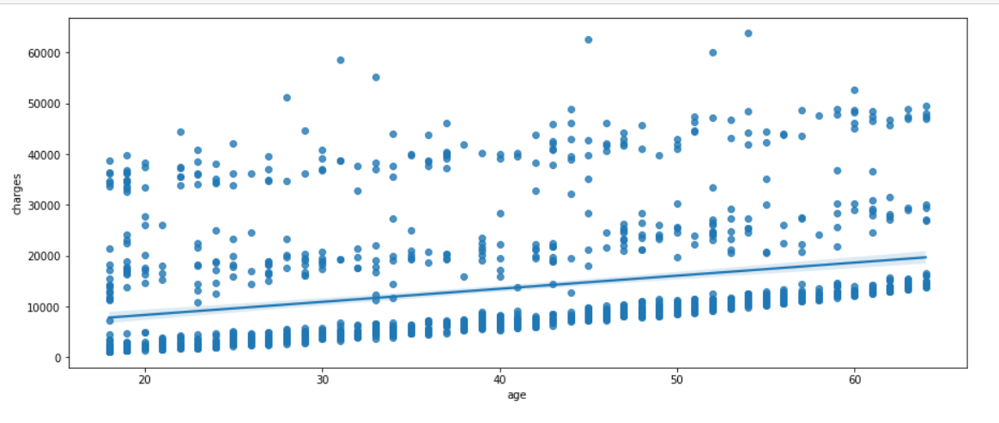
Regression Plot – Age vs. Charges

Slide 10
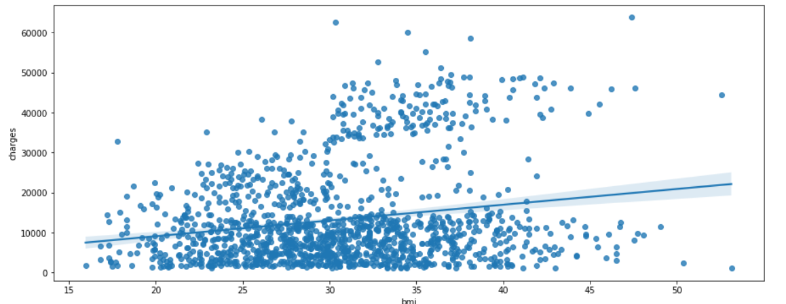
Regression Plot – BMI vs. Charges

Slide 11
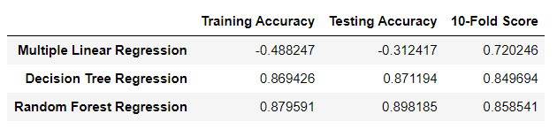
Methodologies used
Multiple Linear Regression
Decision Tree Regression
Random Forest Regression

Slide 12
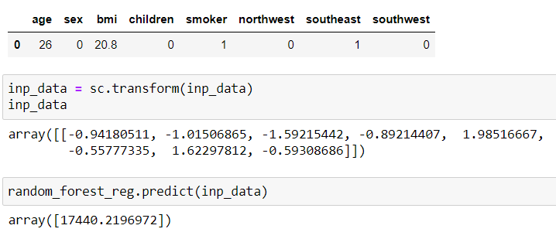
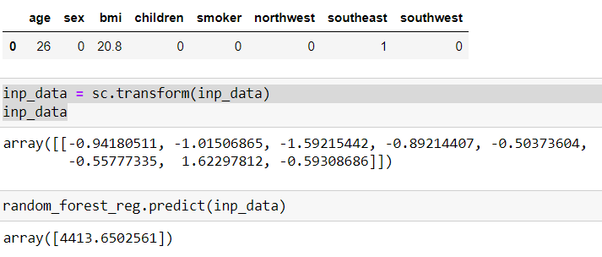
Differences in charges
If_smoker
If_non-smoker

Slide 13
Conclusion
In comparison to the methodologies used, we decided to go with “Random Forest Regression” as it featured a higher accuracy.
A difference in charges based on “Gender” was predicted at the start, but was proved wrong
A significant difference in charges based on people with a habit of smoking was observed
Followed by BMI
Also, Age

